Slide 1

Message and Class ALV
Presented By :
MAHESH GIDDALURU
SAP ABAP

Slide 2

Agenda
Message Types
Text Elements
Message Class
Class ALV
Features

Slide 3
MESSAGE
Messages are used to describe what is happening in the program execution to the programmer or user. Messages represents with a three-digit number. Messages range starts from 000 to 999.
Message Types:
There are six types of Messages. Those are
Termination - A
Error - E
Information – I
Status – S
Warning – w
Exit - X

Slide 4
MESSAGE TYPES
A | Termination | The message appears in a dialog box, and the program terminates. When the user has confirmed the message, control returns to the Next-highest area menu
E | Error | Depending on the program context, an error dialog appears or the program terminates.
I | Information | This message appears in the dialog box, once the user has confirmed the message, the program continues immediately after the MESSAGE statement
S | Status | The program continues normally after the MESSAGE statement, and the message is displayed in the status bar of the next screen
E | Exit | No message is displayed, and the program terminates with a short dump. Program terminations with a short dump normally only occur when a runtime error occurs
W | Warning | Depending on the program context an error dialog appears or the program terminates

Slide 5
MESSAGE USAGE
Messages can be added to the program mostly in two ways. Those are –
Coding directly in the program
By using the message class.
Coding directly in the program -
Coding the message directly in the program is a very simple process. No definition was required before coding the message in the program.
Syntax:-
MESSAGE {message-name} TYPE {message-type}.
Message - 80 characters user defined message.
Message-type - Specifies the message type.

Slide 6
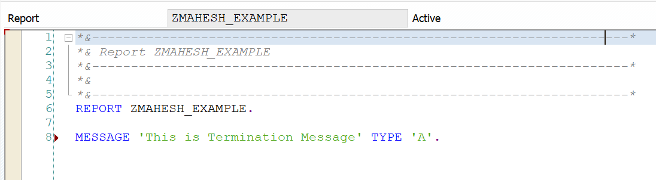
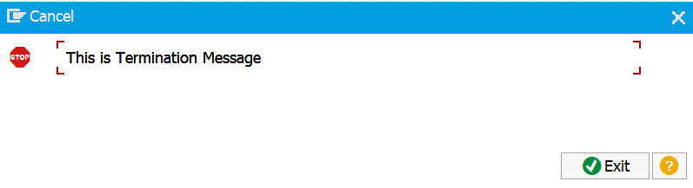
TERMINATION MESSAGE
Termination Message appears in a dialog box, and the program terminates. When the user has confirmed the message, control returns to the next-highest area menu.

Slide 7
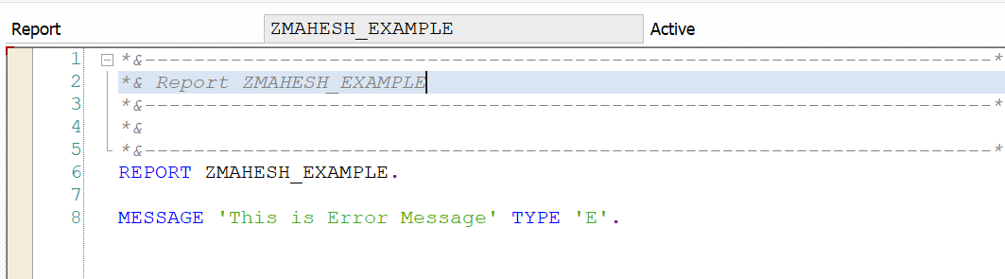

ERROR MESSAGE
Error message in report programs will be displayed in the status bar and when the user press enter, the program terminates.

Slide 8
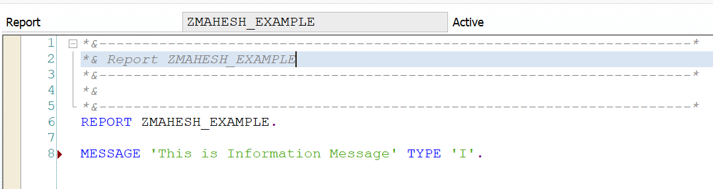
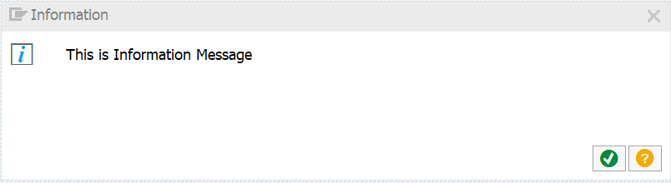
INFORMATION MESSAGE
Information message will be displayed in a dialog box. Once the user has confirmed the message, the program continues immediately after the MESSAGE statement.

Slide 9
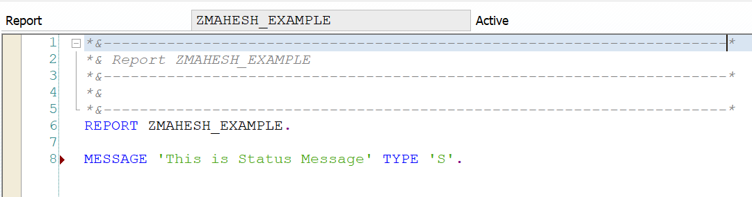

STATUS MESSAGE
Status message will be displayed in the status bar. After the message is displayed the program continues after the MESSAGE statement.

Slide 10
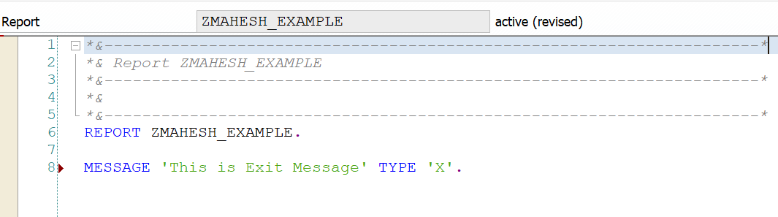
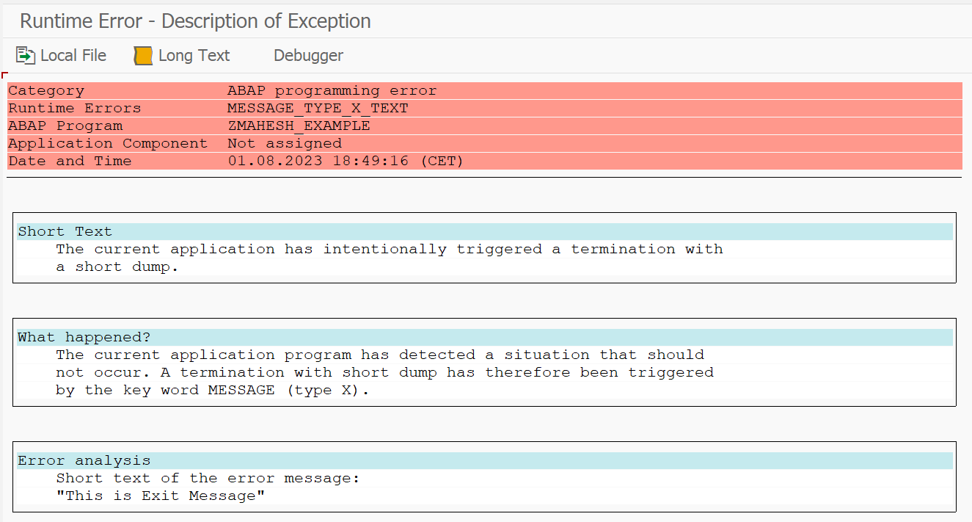
EXIT MESSAGE
Exit Message – No message is displayed, and the program terminates with a short dump. Short dumps can be viewed in t-code ST22.
Warning message behaves similar to error message in report programs

Slide 11
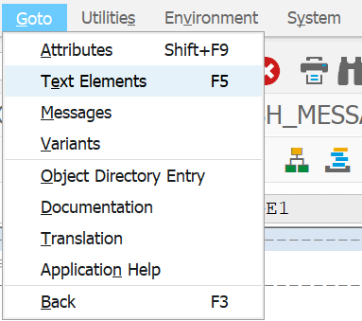
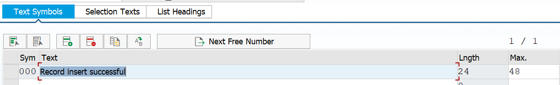
Instead of Hardcode the message text in the program we can maintain the message text in text symbols.
In order to maintain text symbols, use the menu path Goto->Text Elements
In the text symbol screen, we can maintain the messages with a 3 digit-number Identifier.

Slide 12
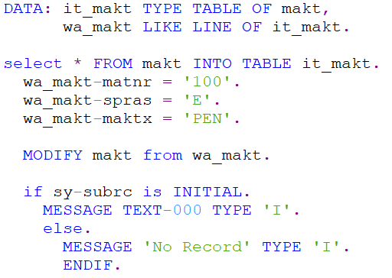
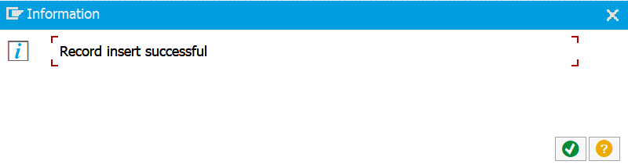
Example

Slide 13
MESSAGE CLASS
Message Class is a like a container which holds several different messages. Each message in the message class is identified with unique message number. So, when you call a message in an ABAP Program , you need to specify the message class and message number.
MESSAGE-ID
It is a key word which is used to assign the message class to our report so that, our report can access all the messages in the message class.

Slide 14
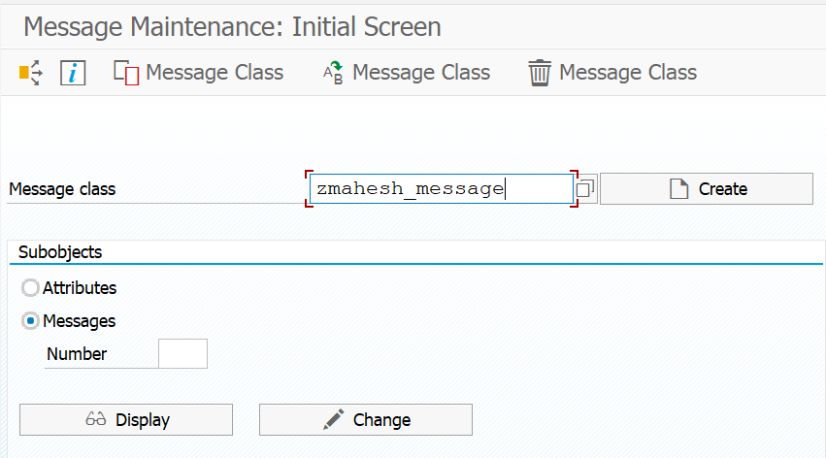
Create Message class
First Go to T-code SE91 for Message Maintenance
Enter the name of the message class.
click on create button.

Slide 15
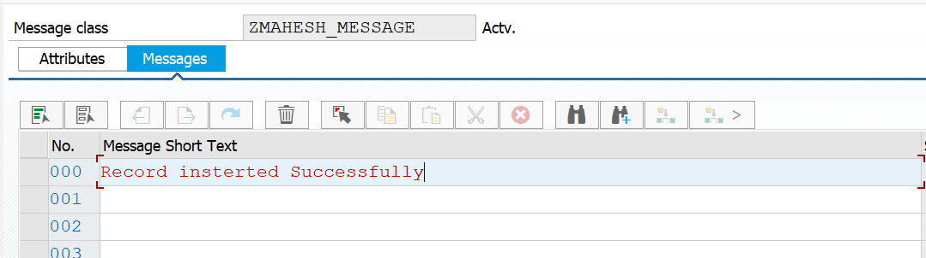
Maintain the required message texts with message numbers. Then save the entries and assign it to proper development class and transport request. Once the message class is saved, we can use it in our ABAP Program.

Slide 16
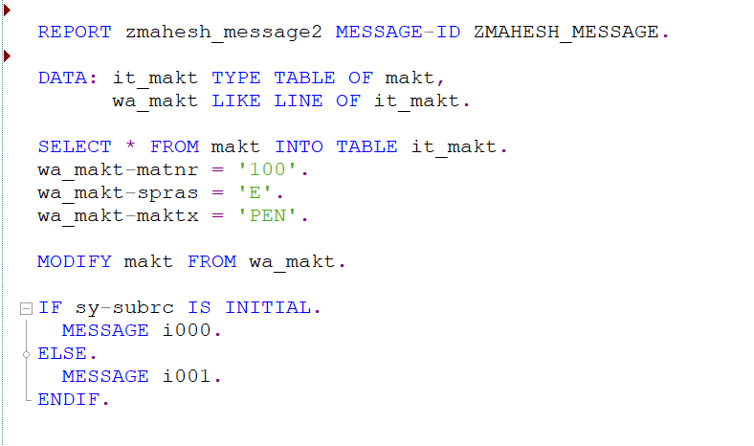
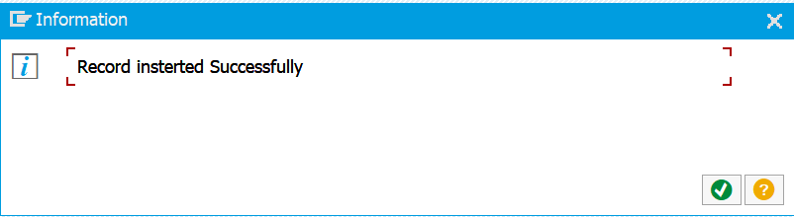
Message Class

Slide 17
CLASS ALV(ABAP LIST VIEWER)
CL_SALV is "Class Sap ABAP List Viewer." It refers to the set of classes provided by SAP for creating ABAP List Viewer (ALV) reports in SAP ABAP programming. The CL_SALV classes offer an object-oriented approach to ALV development, providing more flexibility, better code organization, and reusability compared to the REUSE_ALV function modules.
These ALV object oriented model has advantages:
Simplified design: This Model uses a highly integrated object oriented design which provides the simplicity to programmers to develop the ALV.
Unified Object models: This model has only one main class which will get and set the parameters of entire layout.

Slide 18
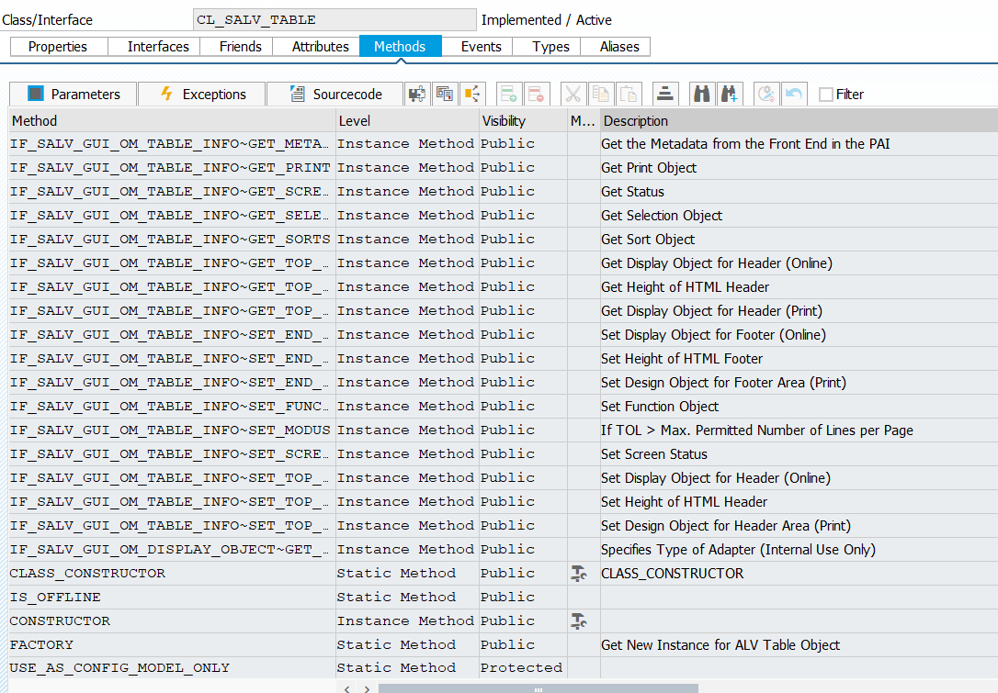
To check CL_SALV_TABLE class we use T-code SE24 we can find many Methods that we can use to customize ALV list

Slide 19
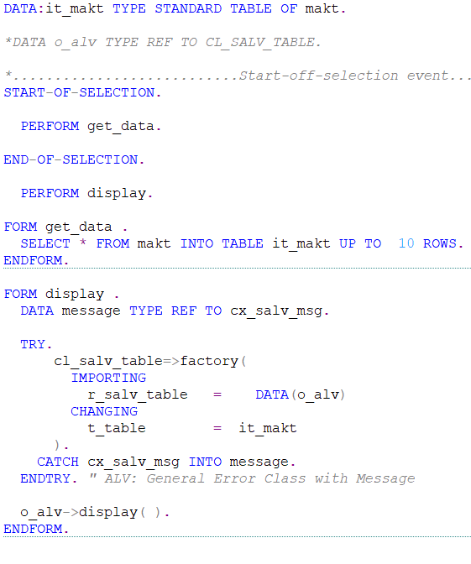
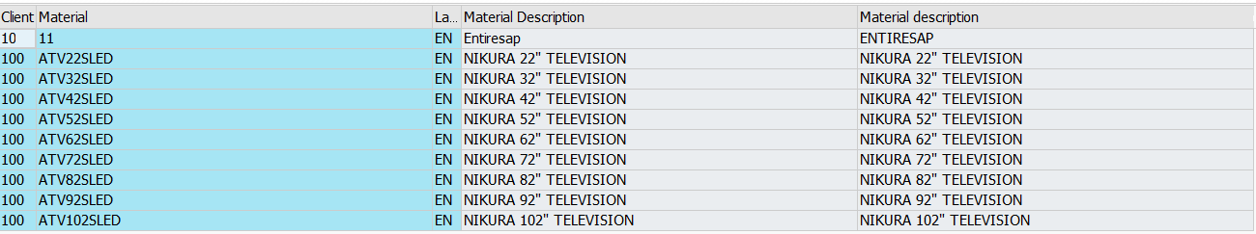
EXAMPLE:-

Slide 20
cl_salv_table=>factory( IMPORTING r_salv_table = DATA(o_alv) " Basis Class Simple ALV Tables CHANGING t_table = it_makt ).
CL_SALV_TABLE factory method is called to create an ALV table.
Reference to the ALV table object is returned and stored in the Variable o_alv.
The data to be displayed in the ALV table is passed through the changing parameter ‘t-table’ which is represented by the internal table ‘it_makt’.

Slide 21
CLASS ALV FEATURES
CL_SALV is a set of features and classes in SAP ABAP used to create interactive ALV reports. Some of the common features include:
Data Display :- Displaying data in a tabular format with column headers and rows.
Sorting:- Ability to sort data in ascending or descending order based on column values.
Column Resizing:- Adjusting the width of columns to fit the data.
ALV Layout Variants: You can define different layout variants to save and switch between different ALV settings.

